Slide 1

Tableau presentation
by Abhay shukla

Slide 2
Tableau data visualization
in this presentation we will analyze annual report of a clothing store in detail.
Then we will share some meaningful insights to increase amount of sales and quantity of orders to improve the overall profit of that store.
We will do this presentation with the help of tableau dashboard visualization.

Slide 3
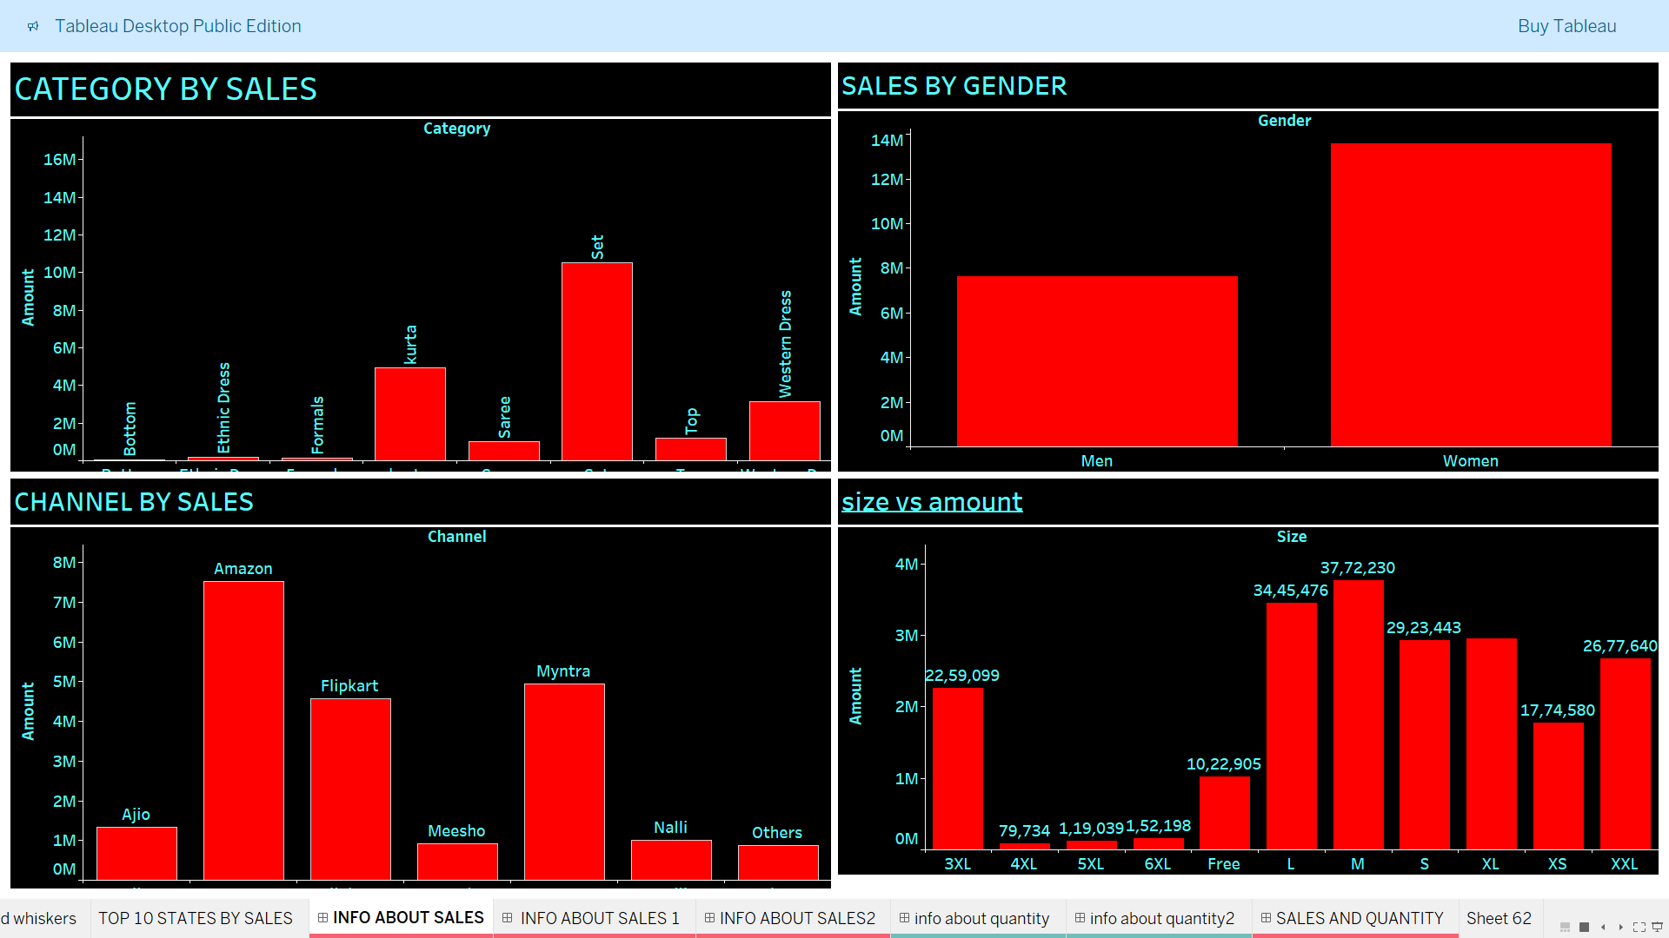
Dashboard about total amount of sales.
In this particular dashboard,i just want to represent what is the total amount of sales across various domains like categories of cloths,gender,channels etc.
Particular domains in described dashboard are as-
by category by gender
by channel(e-commerce site) by size
Points to note:-
“Set” is the item across various categories that gives maximum amount of sales.
As bargraph indicates “Women” spend more amount on buying cloths than men.
“Amazon” is ranked first for amount of sales followed by myntra.
“Medium” size is giving highest no of sales among all sizes available

Slide 4
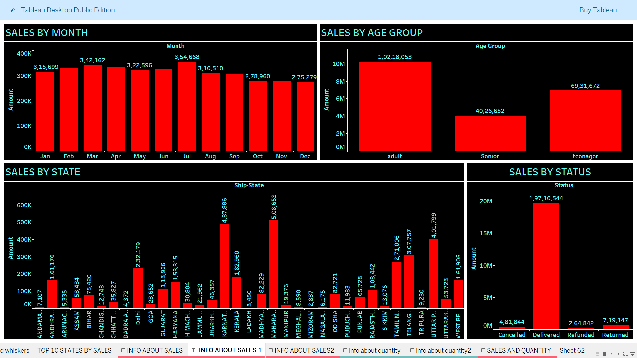
Dashboard about total amount of sales.
Particular domains in described dashboard are as-
by month by age group
by state by delivery status
Points to note:-
Actually all the month are producing more or less same no of amount of sales.but comparatively July is more better than all the months.
As bargraph indicates “adult” age group spend more amount on buying cloths than teenagers and seniors.
“maharashtra” is ranked first for amount of sales followed by karnataka.
“delivered” orders are giving highest no of sales among all sizes available

Slide 5
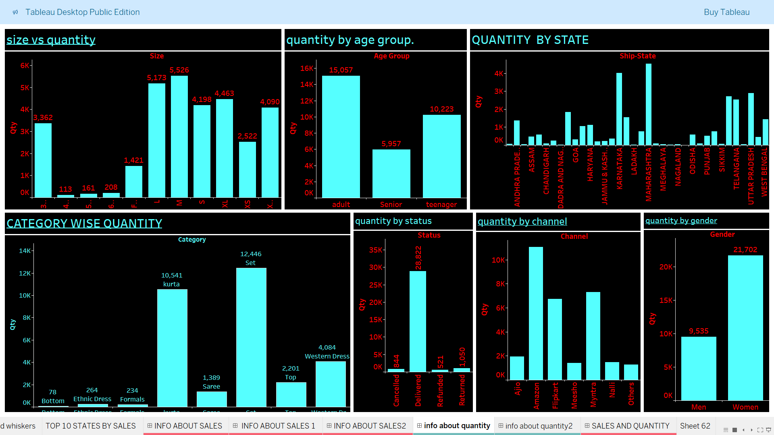
Dashboard about quantity.
This dashboard is representing total number of quantity across various domains like category,channel,gender,age group,state etc……
Results are as obvious like as they were for total amount of sales.

Slide 6
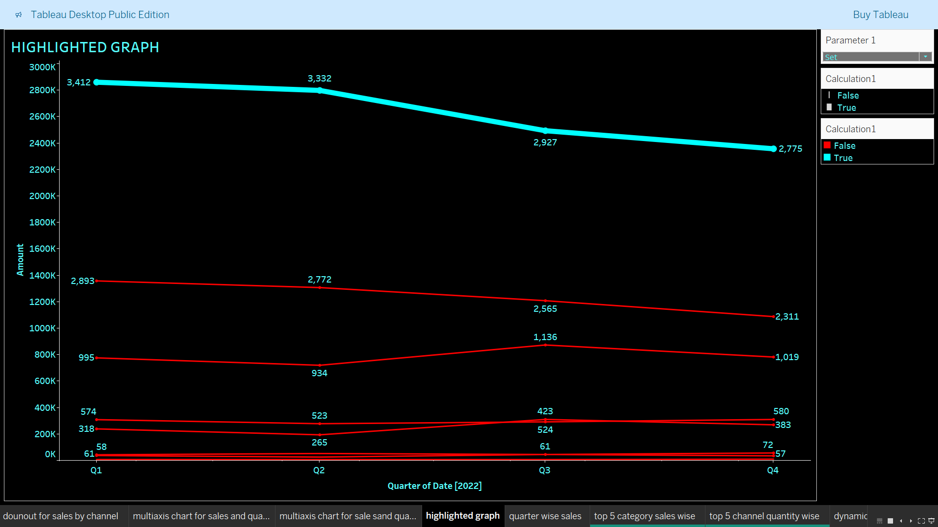
Dashboard about sales.
In this provided line graph,the highlighted line is clearly showing the gap between
Category ”set” and other category.
It is the category whose demand is most.

Slide 7
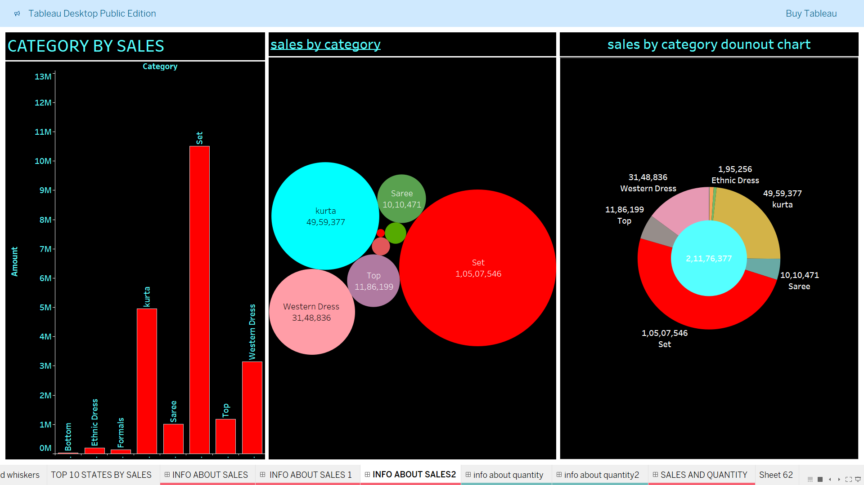
Dashboard about sales by various graph.
In this we are showing total amount of sales by category through various graphs like bubble chart,donut chart etc.
The outcome of these graphs we have discussed already.

Slide 8
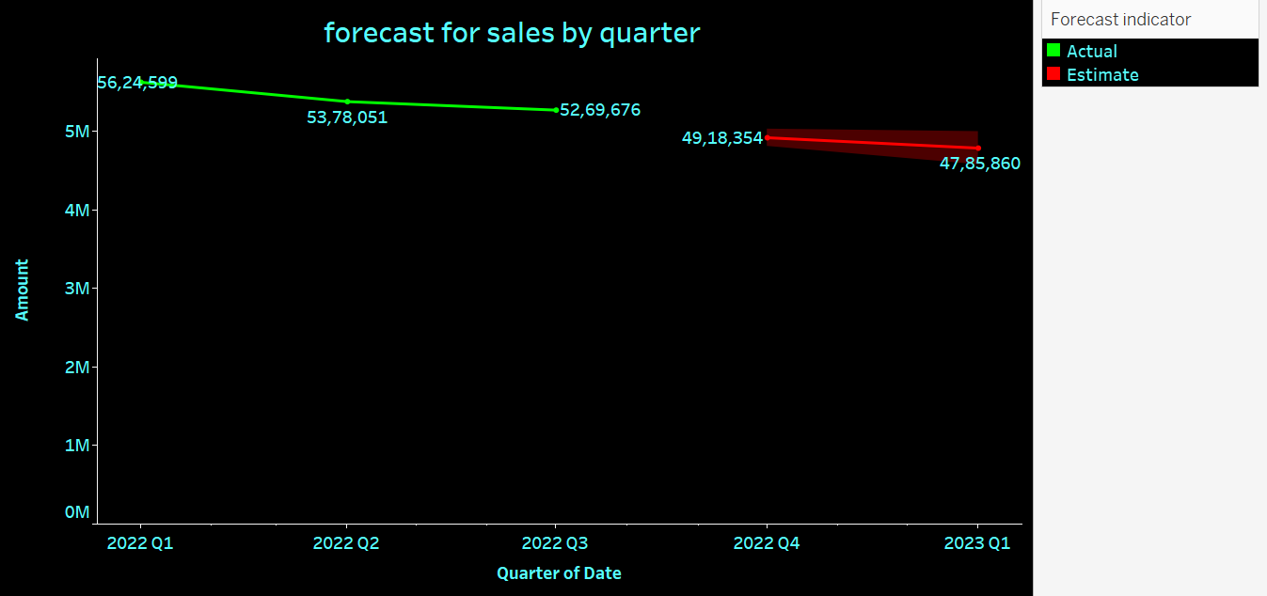
Dashboard about forecast of sales.
Here we are representing the forecast for total amount of sales on the basis of available data

Slide 9
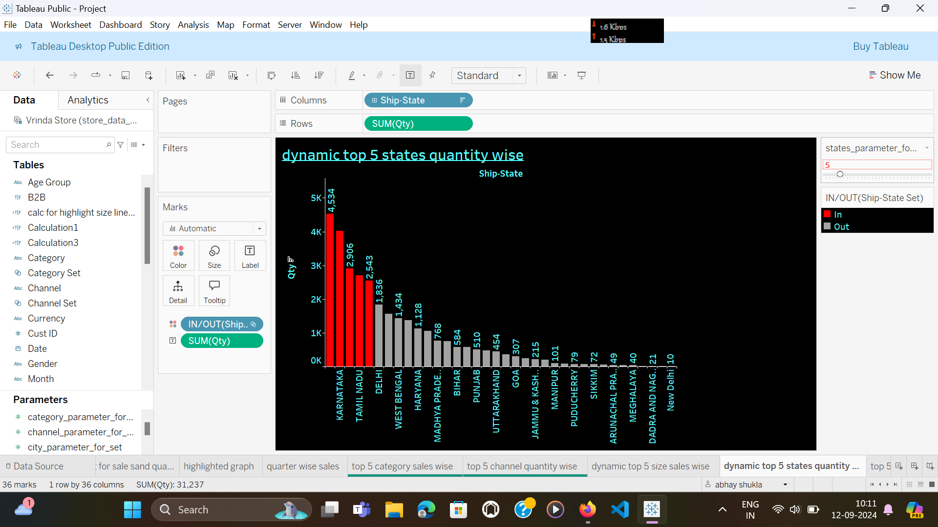
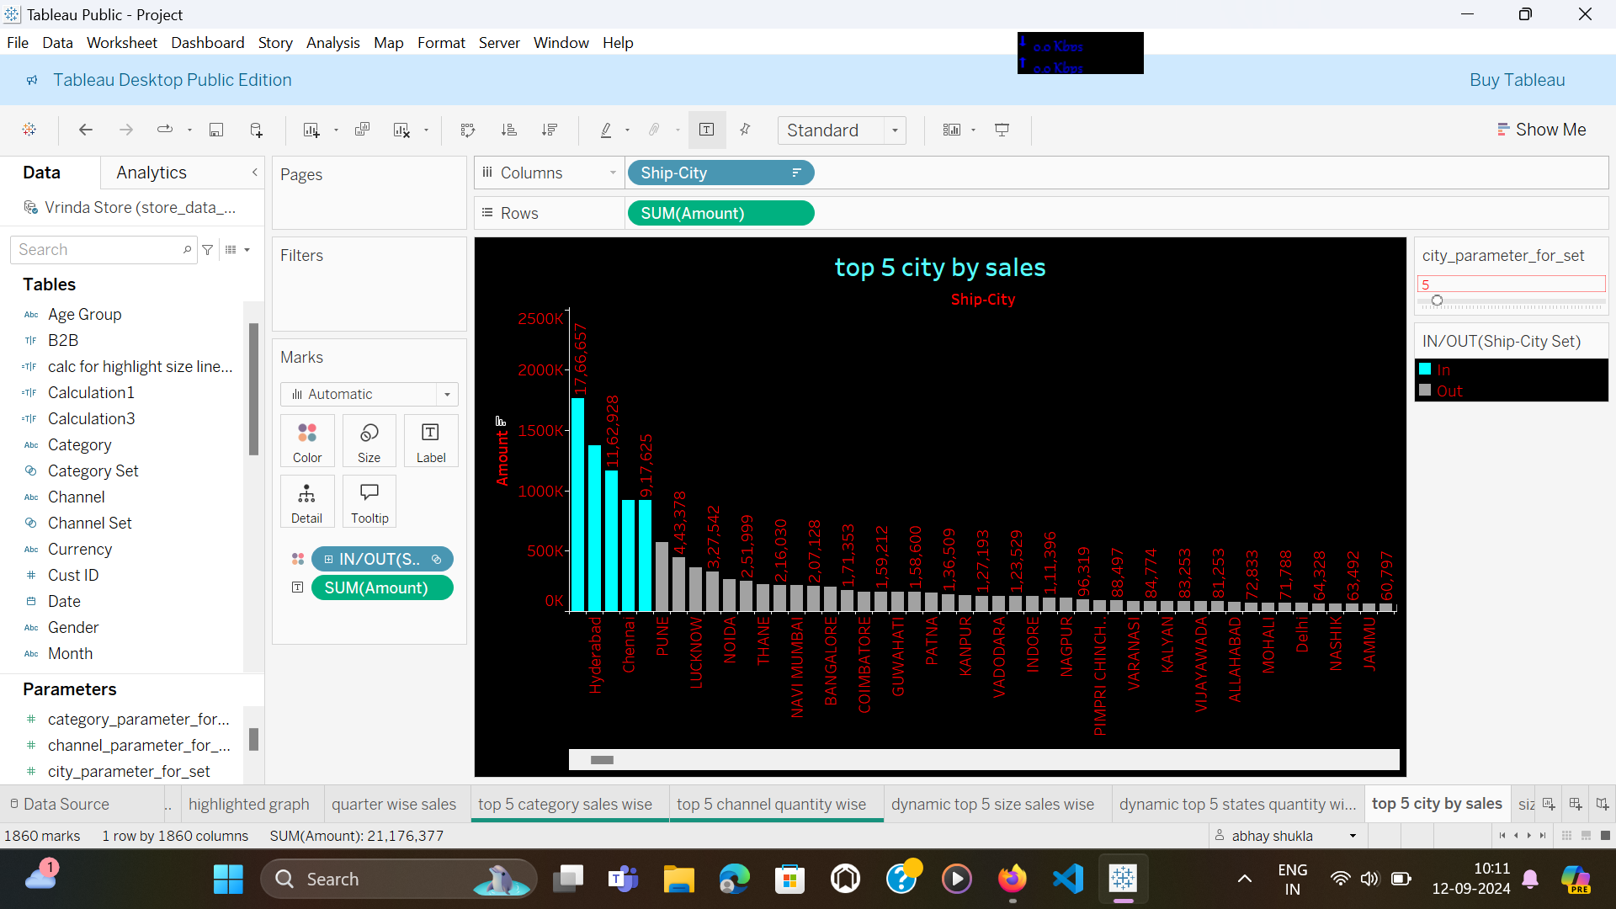
Dashboard about top city and states by sales.
maharashtra is the top state and bengaluru is the top city in terms of total amount of sales.

Slide 10
Insights from data.
Women are more likely to buy compared to men(~65%)
Karnataka and uttar Pradesh are the top 3 states.
Adult age group(30-49 yrs) is max contributing(~50%)
Amazon,myntra and flipkart channels are max contributing.

Slide 11
Final conclusion.
Final conclusion to improve sales of store:-
Target women customers of age group(30-49yrs),
Living in Maharashtra,Karnataka,uttarpradesh.
Show them ads/offers/coupons using AMAZON,FLIPKART and MYNTRA.

Slide 12
Thank you
Have a good day!

